Slide 1

AI COLLEGE ENQUIRY CHATBOT SYSTEM
By
G. Siva Bhaskar Reddy (15001A0550)
&
A. V. Sai Sumanth(15001A0557)
Under the guidance of
Prof. S. Vasundra _{B.E,M.Tech,Ph.D.}
_{N.S.S Coordinator, JNTUA}
DEPARTMENT OF COMPUTER SCIENCE AND ENGINEERING
JAWAHARLAL NEHRU TECHNOLOGICAL UNIVERSITY
COLLEGE OF ENGINEERING(autonomous)
ANANTAPURAMU

Slide 2
Outline
About ChatBot
Features
Implementation
Working
Conclusion

Slide 3
About ChatBot :
User interfaces for software applications can come in a variety of formats, ranging from command-line, graphical, web application, and even voice.
Chat bots typically provide a text-based user interface, allowing the user to type commands and receive text as well as text to speech response.

Slide 4
Features :
College Enquiry ChatBot system is built using AI algorithms mainly Decision Tree algorithm that analyzes user’s queries and understand user’s message.
This System is a web application which provides answer to the query of the user very effectively.

Slide 5
Implementation:
Hardware Configurations
Processor : 1.6 GHz or faster processor
Hard disk : 5GB
RAM : 1GB or more
Software Configurations
Operating System : Windows 7 or above
Languages : Html, Java Servlets
Client server system : Apache tomcat 6.0
Database : MySQL

Slide 6
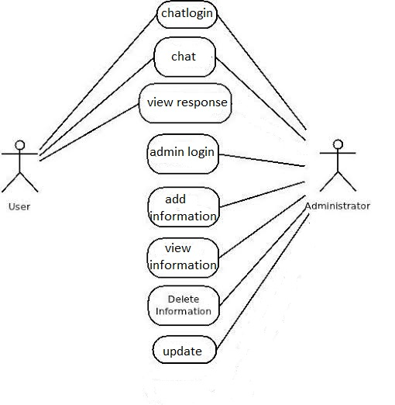
Working
Use case Diagram:

Slide 7
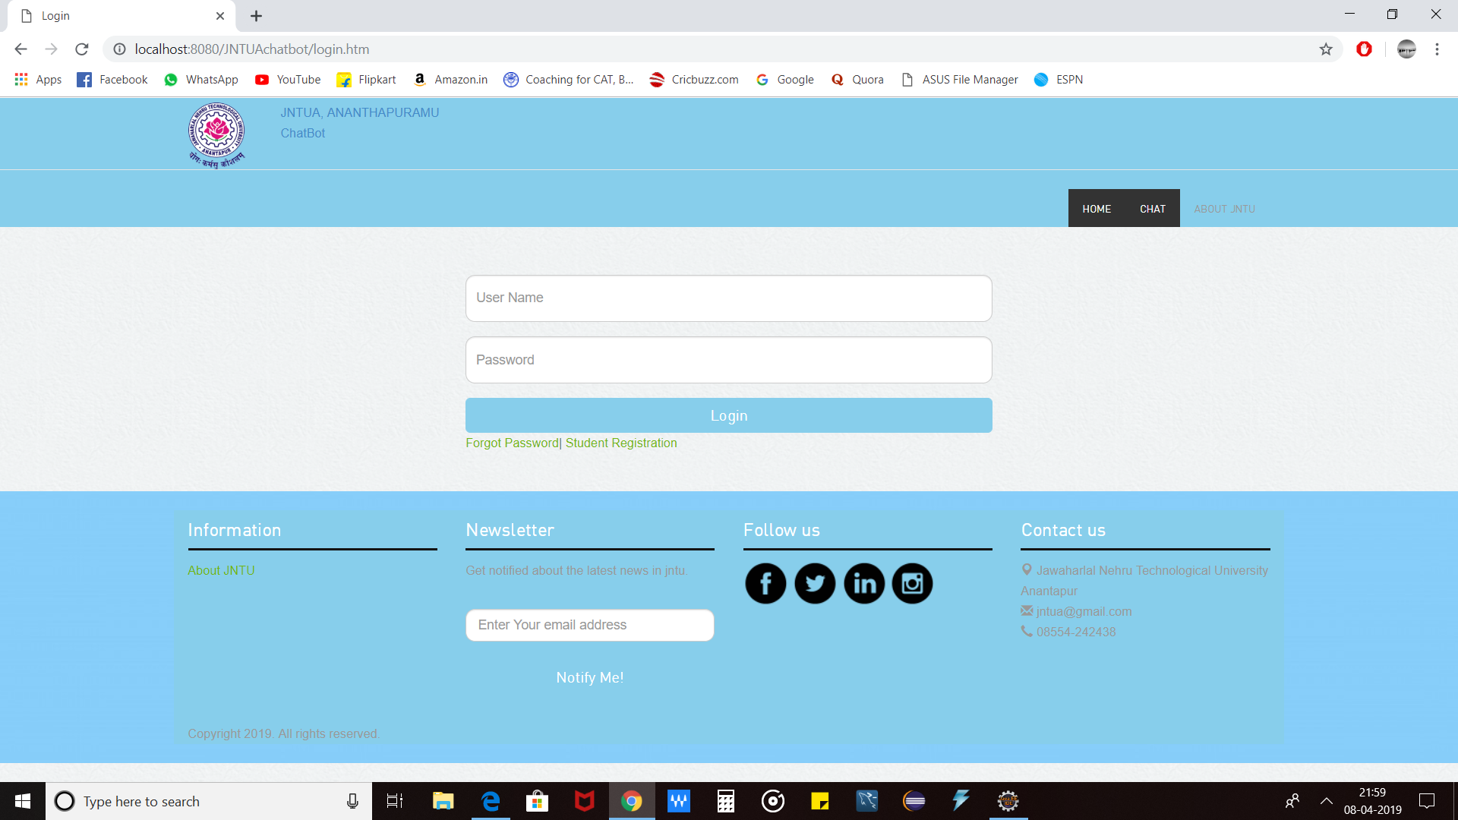

Slide 8
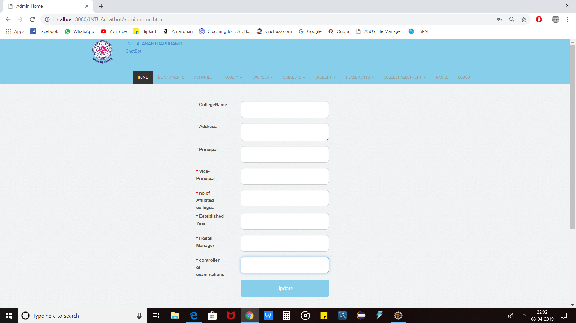

Slide 9
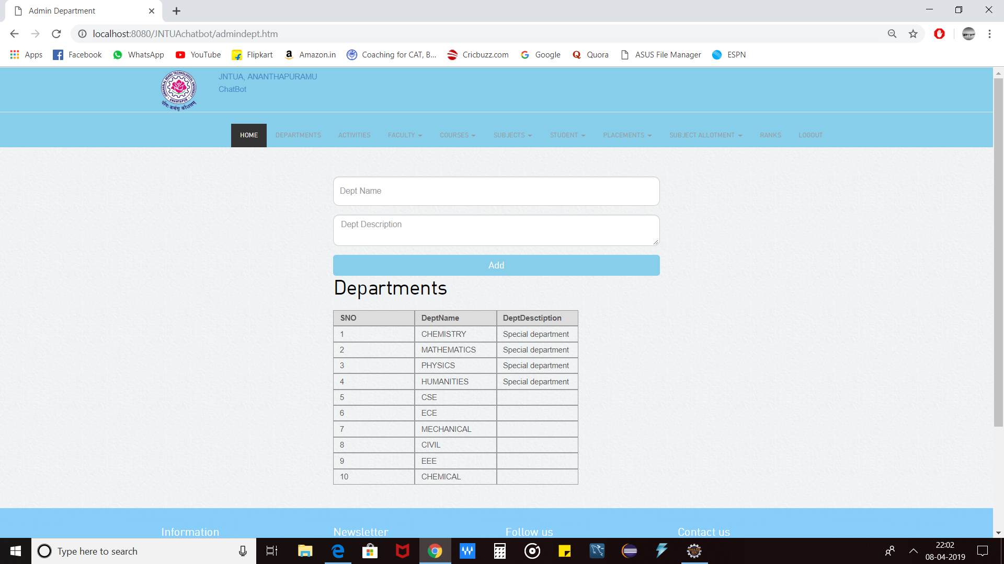

Slide 10
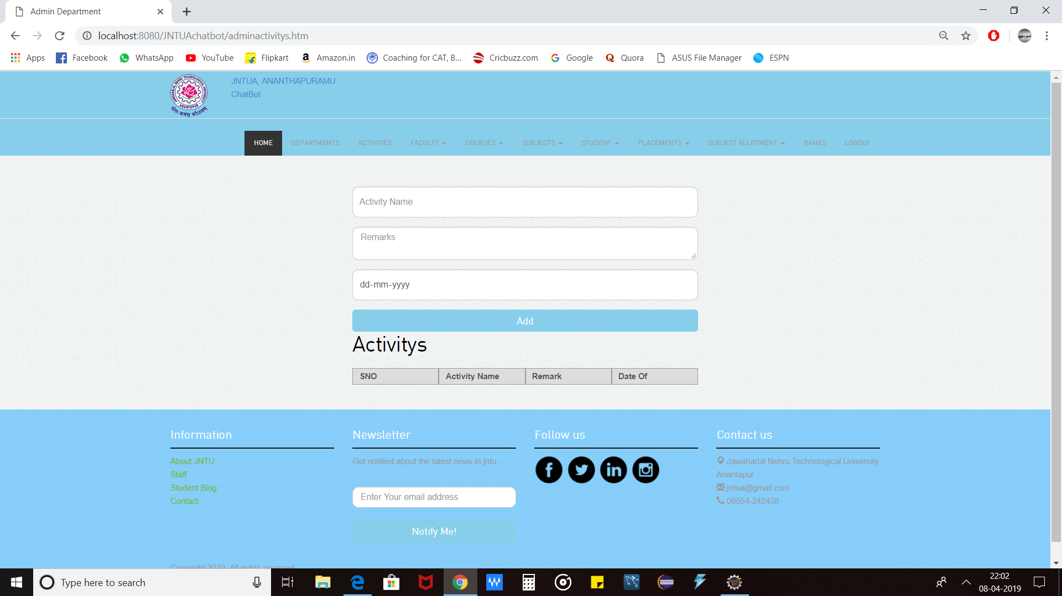

Slide 11


Slide 12
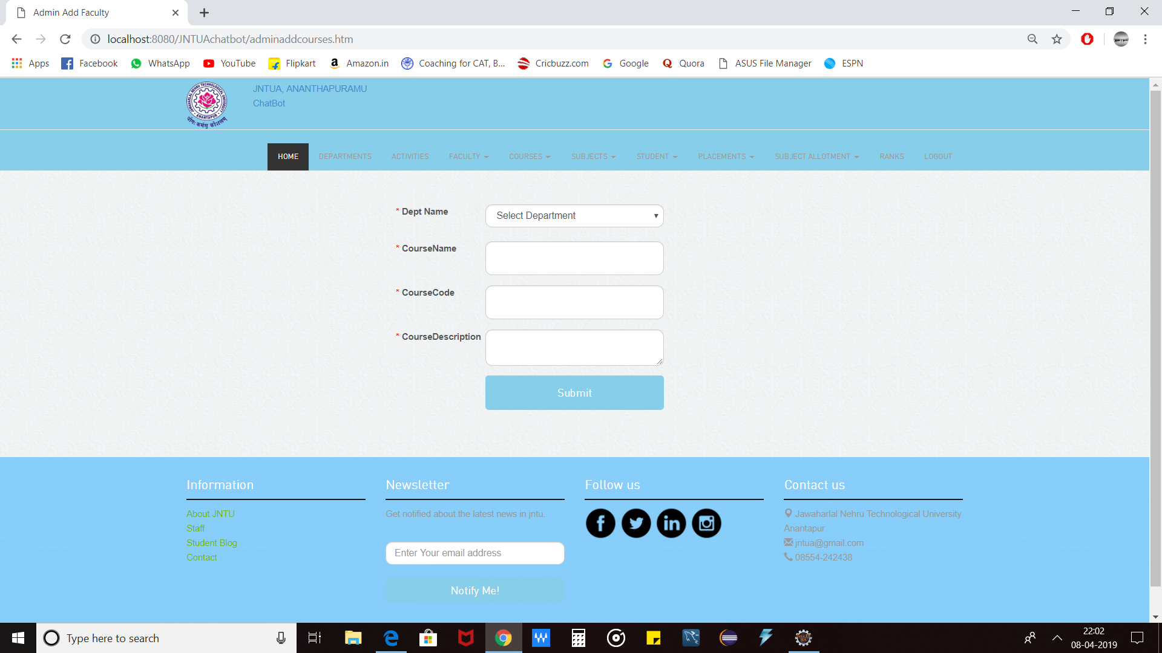

Slide 13
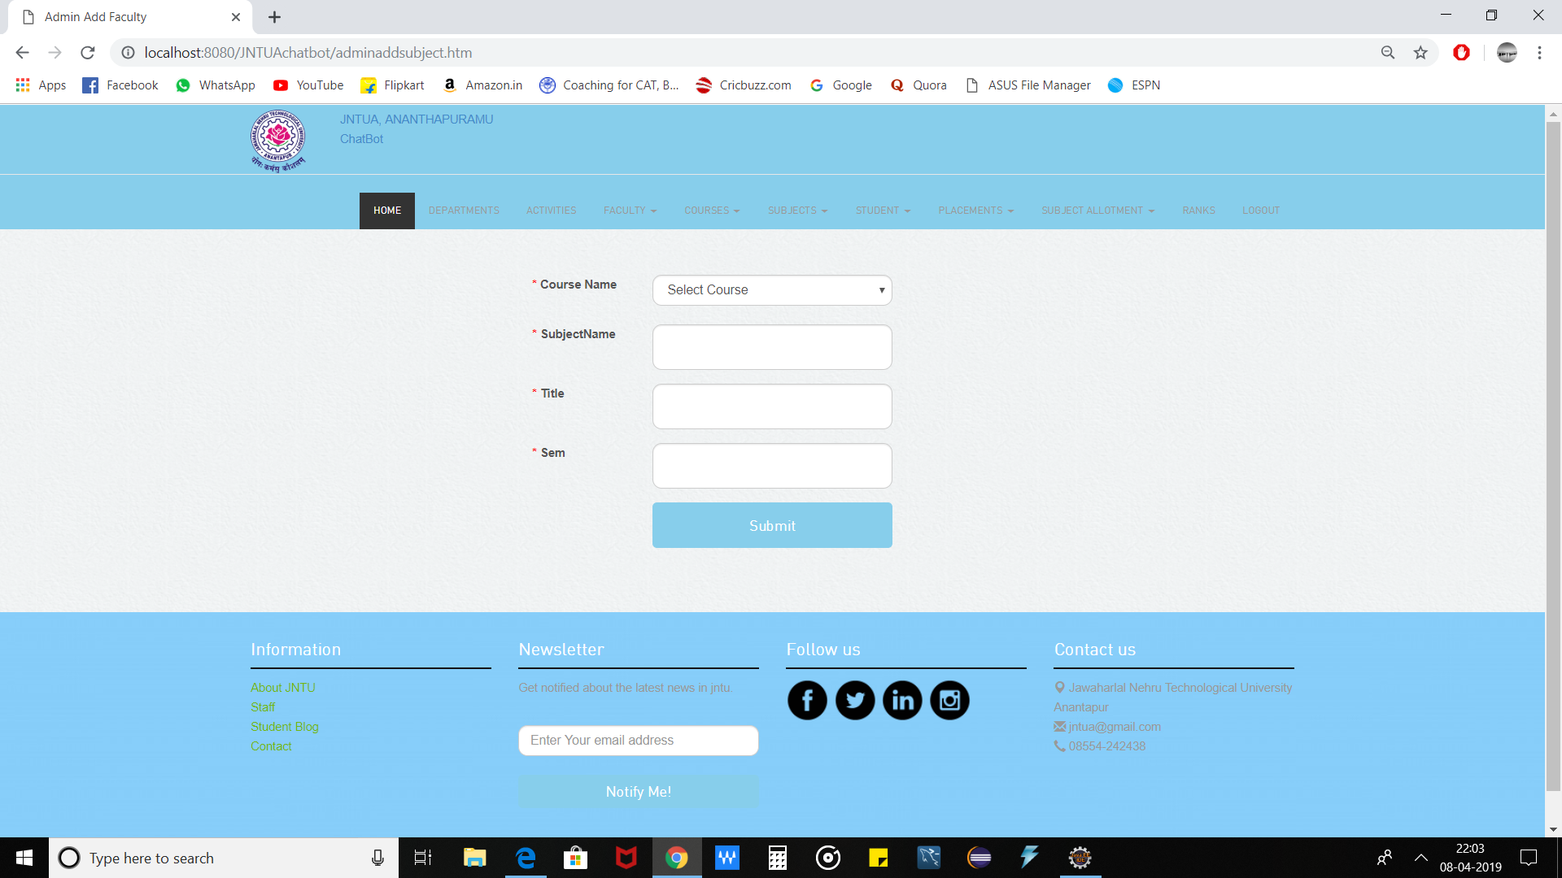

Slide 14
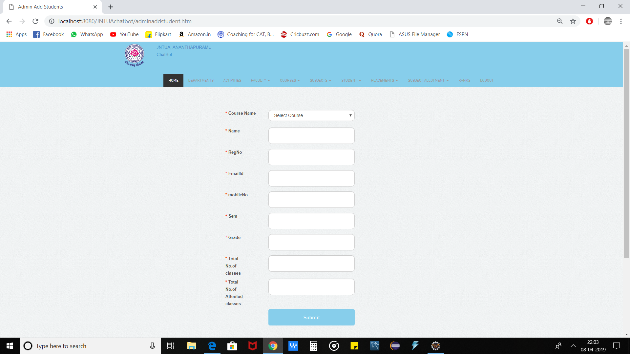

Slide 15
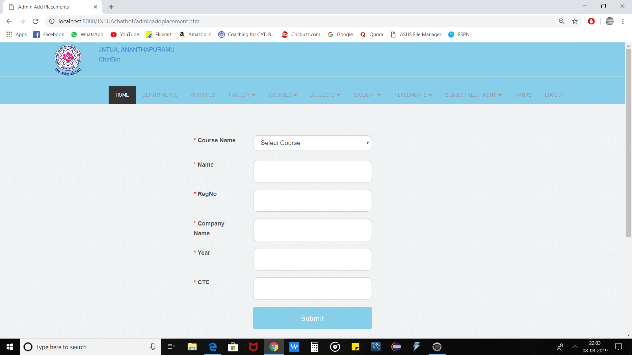

Slide 16
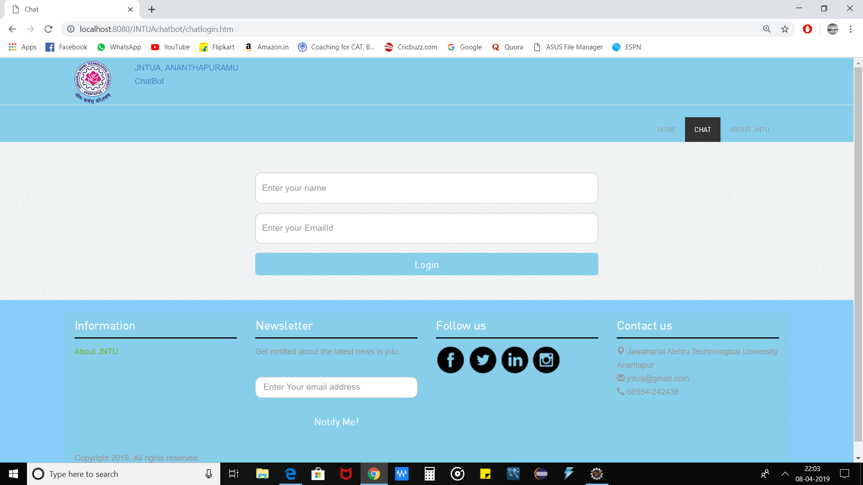

Slide 17
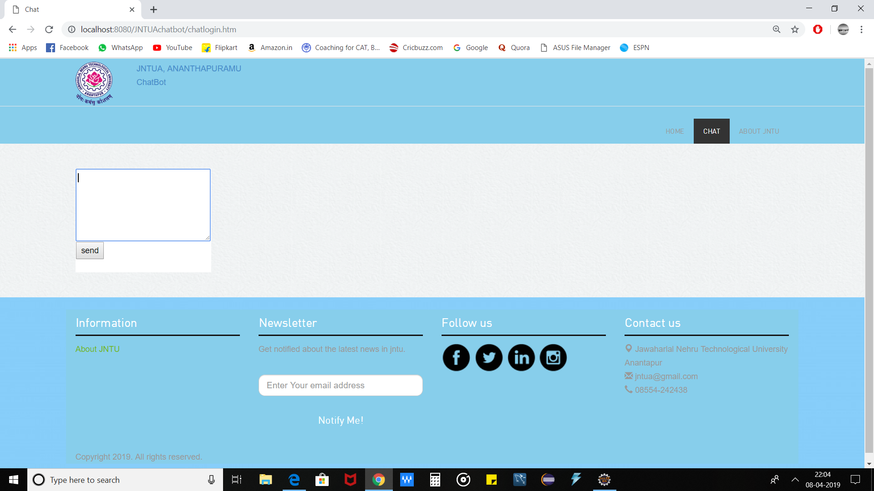

Slide 18
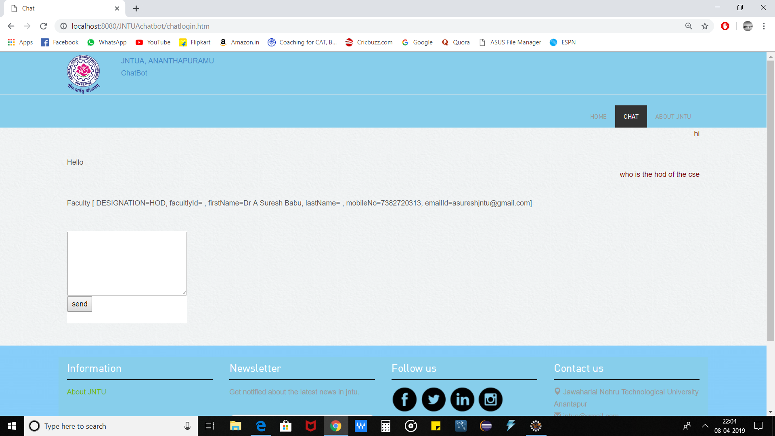

Slide 19
Conclusion :
Overall this project of ours is being developed to help the user to get the information related to college easily.
When chat bot technology is integrated with popular web services it can be utilized securely by an even larger audience.
It also reduce the human efforts.

Slide 20
